Slide 1

Hotel
BUSINESS DASHBOARD
Saurabh Kulkarni
FEBRUARY 2025
email - saurabh8294@gmail.com
mobile - 8411070179

Slide 2

SAURABH KULKARNI
DATA ANALYST
I am a data analyst in the making, certified in Power BI, SQL, and Advanced Excel.
While assisting with the redevelopment of the hotel’s billing software, I gained a deep understanding of its database structure. This knowledge became the foundation for building a powerful dashboard to analyze and optimize business performance.
PROJECT BACKGROUND
At Hotel O2, I proposed contributing my expertise in Power BI to provide the owner and management with a clear top-level view of the business. I developed a dashboard that offers insights into revenue trends, customer demographics that can empower smarter and data-driven decisions.

Slide 3



WHAT’S INSIDE
Revenue Analysis
Demographic Analysis
Optimization Analysis
This analysis highlights key revenue trends, seasonal fluctuations, and actionable insights to drive consistent growth.
Understand customer preferences and booking patterns to enhance loyalty and attract new customers.
Explore operational efficiencies through checkout timings, session trends, and weekday vs. weekend behaviors.

Slide 4
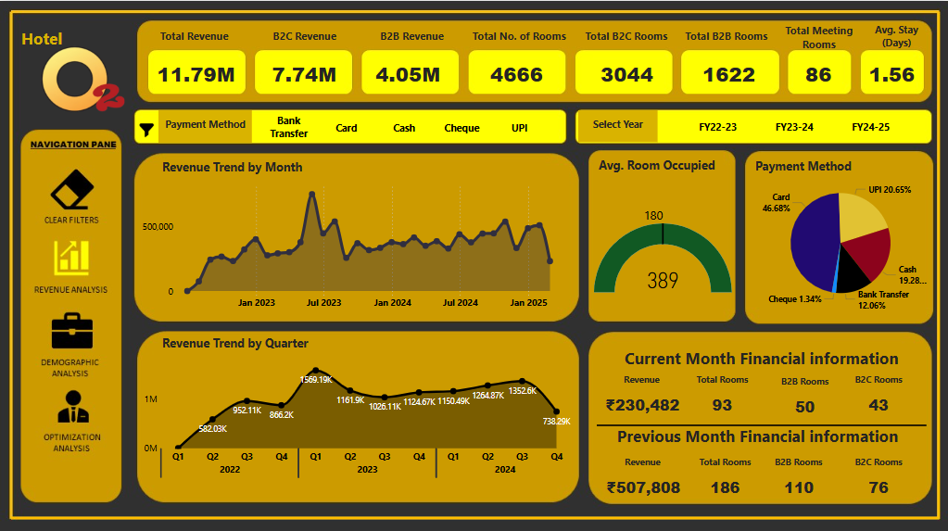
REVENUE ANALYSIS
Understanding revenue trends is crucial for identifying growth opportunities and addressing potential challenges. This analysis dives deep into monthly and quarterly revenue performance, highlighting key parameters like, Average Room occupied, Revenue from different payment methods, etc. By examining these trends, we can strategize effectively to maximize profitability and ensure consistent business growth.

Slide 5
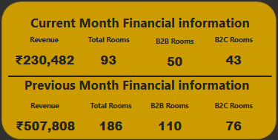
REVENUE ANALYSIS
Revenue Breakdown:
It highlights total revenue, number of rooms booked, and the split between B2B and B2C bookings.
Ongoing Performance:
The current month's data is still updating as more bookings and revenue are recorded.
Business Segmentation:
The report helps in understanding the contribution of B2B and B2C segments to overall revenue.

Slide 6
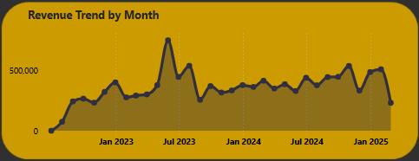
REVENUE ANALYSIS
Steady Growth:
From January 2023 onwards, the revenue trend shows a steady increase with minor fluctuations.
Peaks observed in mid-2023, likely due to seasonal demand.
Consistent Performance:
Despite small drops in certain months, overall stability is maintained, resulting a healthy revenue stream.

Slide 7
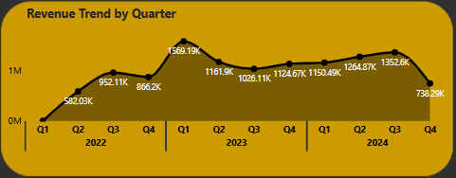
REVENUE ANALYSIS
Quarterly Peaks:
Highest revenue observed in Q3 2023, indicating strong performance in that quarter.
Gradual increases leading into 2024, with Q2 and Q3 2024 continuing the upward trend.
Consistent Quarter-on-Quarter Growth:
Revenue stability is reflected across multiple quarters.
Performance remains robust despite some minor dips.

Slide 8
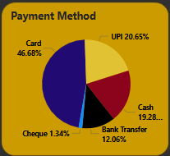
REVENUE ANALYSIS
Dominance of Card Payments (46.68%)
Nearly half of all transactions are completed using cards, showcasing their popularity and ease of use among customers.
UPI as a Secondary Preference (20.65%)
UPI ranks second, indicating a growing trend of digital payments, especially among tech-savvy customers.
Significant Use of Cash (19.28%)
Cash remains relevant for a considerable portion of transactions
Bank Transfers and Cheques (12.06% and 1.34%)
Bank transfers see occasional use, while cheques have the least traction, indicating a shift toward quicker payment modes.

Slide 9
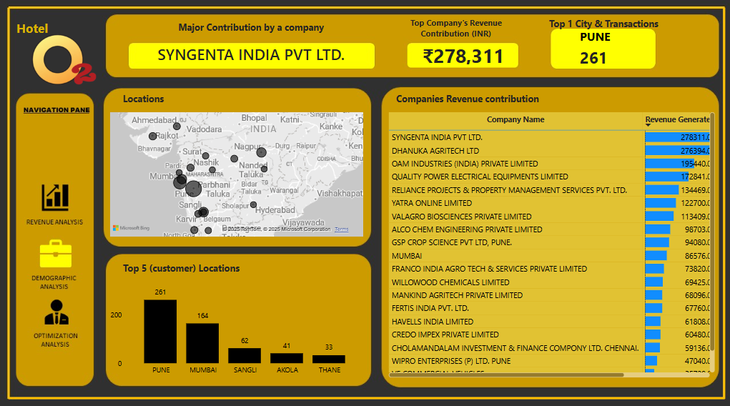
DEMOGRAPHIC ANALYSIS
A thorough understanding of customer behavior drives targeted decision-making. This analysis focuses on demographic trends, booking patterns, and repeat customer insights. By identifying high-value customer segments and their preferences, we can tailor experiences, improve loyalty, and attract new customers more effectively.

Slide 10
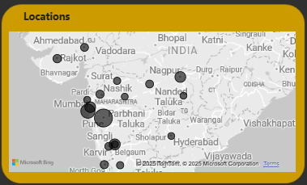
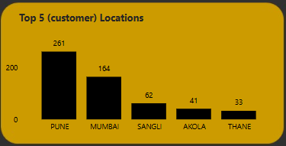
DEMOGRAPHIC ANALYSIS
A map displaying customer locations, emphasizing the major contributing regions.
Pune is the leading city with maximum transactions and revenue contribution.
Mumbai is second best revenue contributor.

Slide 11
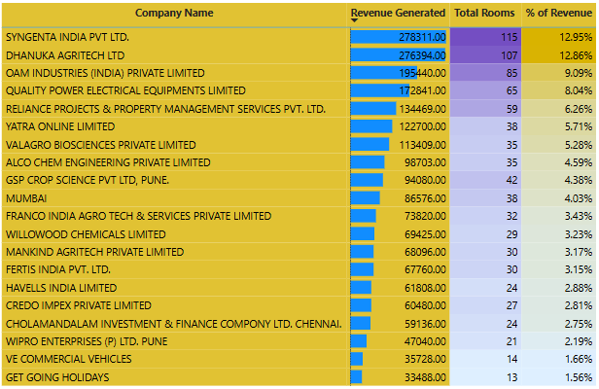
DEMOGRAPHIC ANALYSIS
A table listing top companies by revenue contribution, sorted in descending order.
Major Contribution by a Company: SYNGENTA INDIA PVT LTD. with the Revenue Contribution: Rs. 2,76,394.
Top contributing companies include DHANUKA AGRITECH Ltd, OAM Industries, and others, as shown in the table.

Slide 12
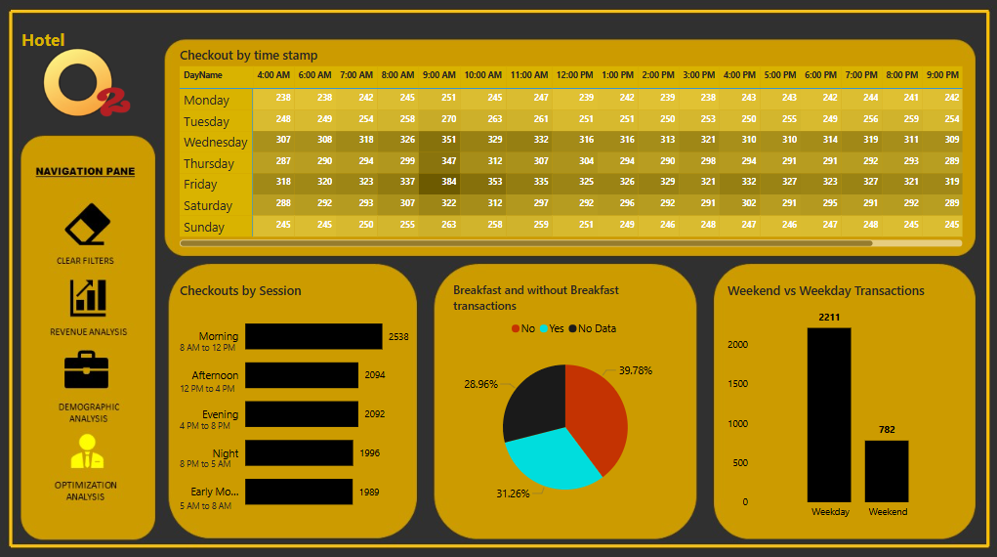
OPTIMIZATION ANALYSIS
Optimizing operations is essential for enhancing customer satisfaction and improving efficiency. This page explores critical metrics such as checkout timings, session-wise customer behavior, and breakfast preferences, alongside weekday vs. weekend trends. These insights provide actionable data to refine staffing, menu offerings, and promotional strategies, ensuring better resource utilization and higher returns.

Slide 13
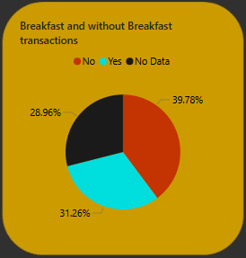
OPTIMIZATION ANALYSIS
Breaks down transactions with and without breakfast options.
Around 39.78% of transactions include breakfast, while 31.26% do not. The remaining percentage accounts for cases where breakfast data is unavailable
Enhance breakfast offerings to convert non-breakfast customers.

Slide 14
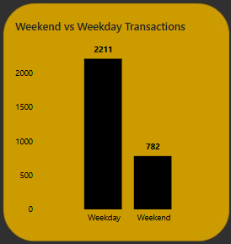
OPTIMIZATION ANALYSIS
Compares the total number of transactions during weekdays versus weekends.
Weekdays account for the majority of transactions (2211 transactions), with weekends significantly lower (782 transactions).
Suggests maintenance related work to be done on weekends.

Slide 15
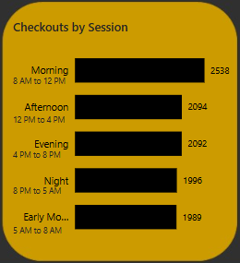
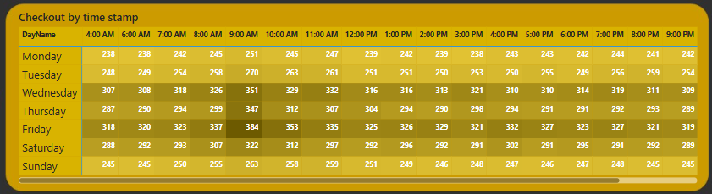
OPTIMIZATION ANALYSIS
The most checkouts happen on Wednesdays and Fridays consistently across the time slots.
The busiest time across all days is 9:00 AM to 10:00 AM, with the highest single count on Wednesday at 9:00 AM (351 checkouts). This indicates a significant morning rush hour.
The time slots between 8:00 AM to 12:00 PM see consistently high checkout numbers across all days, making mornings the most critical period for staff allocation.
Afternoons (12:00 PM to 4:00 PM) experience steady activity but are comparatively less busy than mornings while night time slots (8:00 PM onwards) show a decline in activity.

Slide 16
THANK YOU
FOR YOUR NICE ATTENTION
Saurabh Kulkarni
FEBRUARY 2025
email - saurabh8294@gmail.com
mobile - 8411070179

